Slide 1
Basics
Web Application Architecture.
Web Browser(Front End)
Web Server (Backend)
What happens when you type an address in browser?

Slide 2
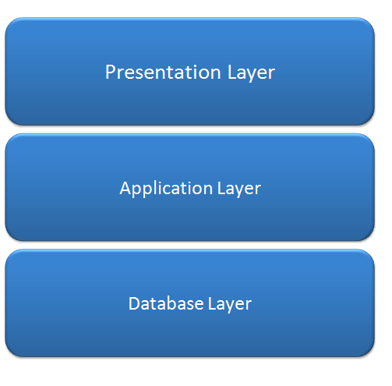
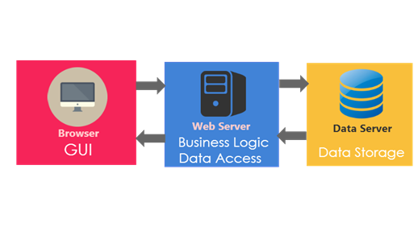

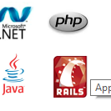

Web Application Architecture

Slide 3
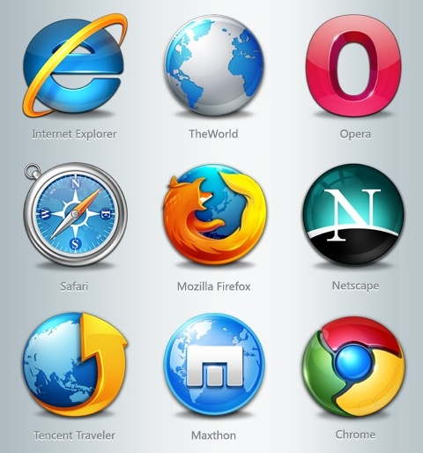
Web Browser
The primary purpose is to bring information resources to the user.
An application for retrieving, presenting, and traversing information resources.
Technology consists of Combination of Html,CSS,Javascript

Slide 4


Web Server
The term web server can mean one of two things:
A computer program that accepts HTTP requests and return HTTP responses with optional data content.
A computer that runs a computer program as described above.

Slide 5
URL
URL-Uniform Resource Locator
Address of a specific webpage or file on the Internet
A URL has two main components:
Protocol identifier: For the URL http://example.com, the protocol identifier is http.
Resource name: For the URL http://example.com, the resource name is example.com.
Eg: Flipkart
https://www.flipkart.com/mobiles?otracker=nmenu_sub_Electronics_0_Mobiles
https:// – the URL prefix, which specifies the protocol used to access the location
www.flipkart.com – the server name or IP address of the server
/mobiles?otracker=nmenu_sub_Electronics_0_Mobiles – the path to the directory or file

Slide 6
MVC Introduction
The ASP.NET MVC is a web application framework developed by Microsoft, which implements the model-view-controller(MVC) pattern. It is open-source software, apart from the ASP.NET Web Forms component which is proprietary.
ASP.NET MVC was designed for creating websites.
Development Environment
Visual Studio
Visual Studio is an IDE, or integrated development environment.
Just like you use Microsoft Word to write documents, you'll use an IDE to create applications

Slide 7
Why MVC
The main advantages of ASP.net MVC are:
Enables the full control over the rendered HTML.
Provides clean separation of concerns(SoC).
Enables Test Driven Development(TDD).
Easy integration with JavaScript frameworks.
Following the design of stateless nature of the web.
RESTful urls that enables SEO.
No ViewState and PostBack events

Slide 8
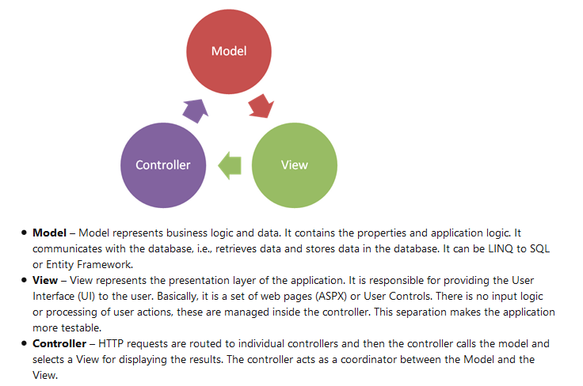
MVC Architecture
It is a loosely coupled development framework as it is divided into three layers.

Slide 9
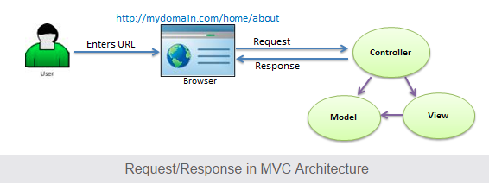
Request Flow in MVC
When the user enters a URL in the browser, it goes to the server and calls appropriate controller. Then, the Controller uses the appropriate View and Model and creates the response and sends it back to the user. We will see the details of the interaction in the next few sections.

Slide 10
ASP.NET MVC Version History
MVC Version | Visual Studio | .Net Version | Release date | Features
MVC 1.0 | VS2008 | .Net 3.5 | 13-Mar-2009 | MVC architecture with webform engine Routing HTML Helpers Ajax Helpers Auto binding
MVC 2.0 | VS 2008 | .Net 3.5/4.0 | 10-Mar-2010 | Area Asynchronous controller Html helper methods with lambda expression DataAnnotations attributes Client side validation Custom template Scaffolding
MVC 3.0 | VS 2010 | .Net 4.0 | 13-Jan-2011 | Unobtrusive javascript validation Razor view engine Global filters Remote validation Dependency resolver for IoC ViewBag

Slide 11
MVC 4.0 | VS 2010 SP1, VS 2012 | .NET 4.0/4.5 | 15-Aug-2012 | Mobile project template Bundling and minification Support for Windows Azure SDK
MVC 5.0 | VS 2013 | .NET 4.5 | 17-oct-2013 | Authentication filters Bootstrap support New scaffolding items ASP.Net Identity
MVC 5.2 - Current | VS 2013 | .NET 4.5 | 28-Aug-2014 | Attribute based routing bug fixes and minor features upate

Slide 12
Points to Remember :
MVC stands for Model, View and Controller.
Model is responsible for maintaining application data and business logic.
View is a user interface of the application, which displays the data.
Controller handles user's requests and renders appropriate View with Model data.

Slide 13
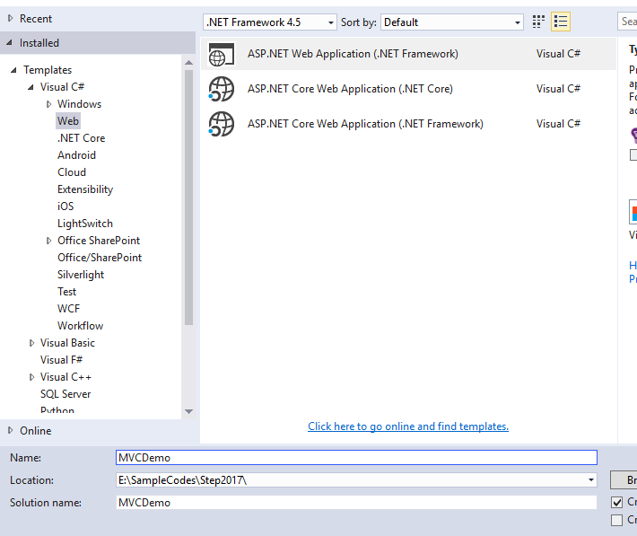
Create first simple MVC application

Slide 14
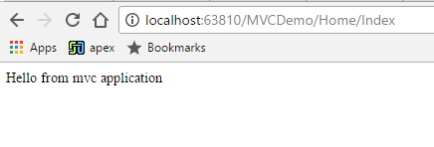
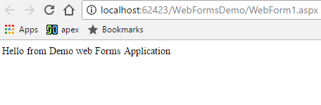
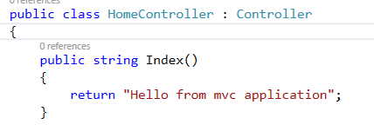
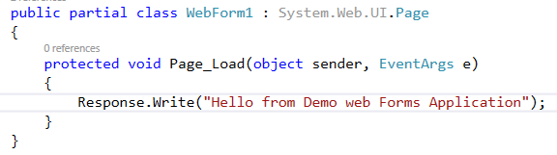
Creating your asp.net mvc application
http://localhost/MVCDemo/Home/index
↓ ↓ ↓
Server Project Controller
http://localhost:62423/WebFormsDemo/WebForm1.aspx
In the URL "Home" is the name of the controller and "Index" is the method within HomeController class.
Where as in web forms application, the URL is mapped to a physical file

Slide 15
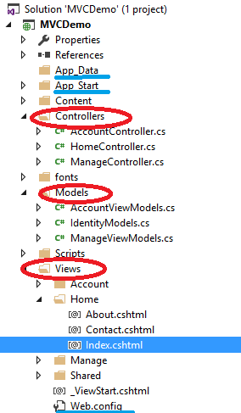
ASP.NET MVC Folder Structure
App_Data: Application data files like LocalDB, .mdf files, xml files and other data related files. IIS will never serve files from App_Data folder.
App_Start: files which will be executed when the application starts.
Controllers: Controllers folder contains class files for the controllers. Controllers handles users' request and returns a response. MVC requires the name of all controller files to end with Controller
Models: Models folder contains model class files for manipulating application data
Views: Html files for application
Separate folder for each controllers. Eg:Home folder for Home Controller .
Shared folder shares files across all controllers. Eg:layout files

Slide 16
Controllers in MVC application
Handles incoming URL request.
Base class System.Web.Mvc.Controller.
Controller class contains public methods called Action methods.
Every controller class name must end with a word Controller. Eg:Controller for student must be StudentController.
Every controller class must be located in Controller folder of MVC folder structure.

Slide 17
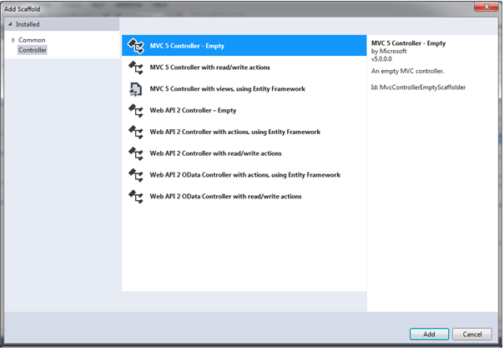
Adding a new Controller
Scaffolding: Automatic code generation framework

Slide 18
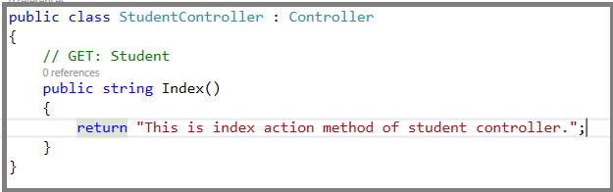
Student Controller derives from controller class.
Base Controller class contains helper methods that can be used for various purposes.
http://localhost/MVCDemo/Home/index invokes Home Controller and index action methods.
http://localhost:63810/MVCDemo/Student/Index invokes Student Controller and index action methods.
How and Where that mapping is defined and stored?

Slide 19
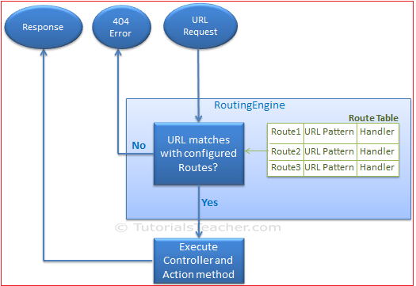
Routing

Slide 20
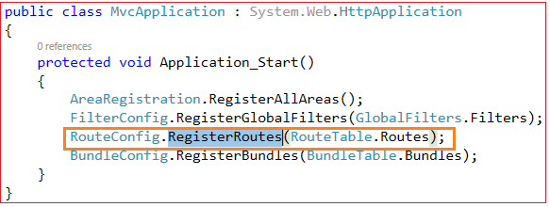
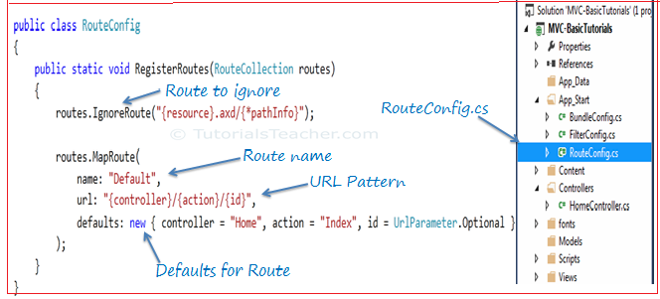

Configure Route
Mapping defined in Global.asax
Register route Method.
http://localhost/MVCDemo/Home/Index
Id is optional
http://localhost:63810/MVCDemo/Home/Index/10

Slide 21
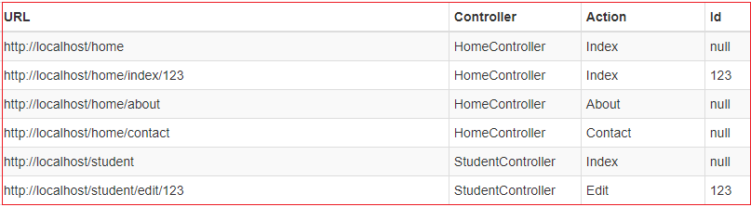
URL Pattern
Considered only after domain name part in the URL
Eg: http://localhost:63810/MVCDemo/Home/Index
http://localhost:63810/MVCDemo/ invokes default parameters

Slide 22
Task
Action Method
Action Verbs
Action Selectors

Slide 23
Views in an mvc application

Slide 24
Models in MVC application

